Slide 1
Chapters 10-12
Selected Exercises

Slide 2
EX 10.10
Explain why SSDs often use a FCFS disk scheduling algorithm.
Because SSDs do not have moving parts and therefore performance is insensitive to issues such as seek time and rotational latency. Therefore, a simple FCFS policy will suffice.

Slide 3
EX 10.11
Suppose that a disk drive has 5,000 cylinders, numbered 0 to 4999. The drive is currently serving a request at cylinder 2150, and the previous request was at cylinder 1805. The queue of pending requests, in FIFO order, is: 2069, 1212, 2296, 2800, 544, 1618, 356, 1523, 4965, 3681. Starting from the current head position, what is the total distance (in cylinders) that the disk arm moves to satisfy all the pending requests for each of the following disk-scheduling algorithms? a. FCFS b. SSTF c. SCAN d. LOOK e. C-SCAN f. C-LOOK.
The FCFS schedule is 2150, 2069, 1212, 2296, 2800, 544, 1618, 356, 1523, 4965, 3681. The total seek distance is 13,011.
The SSTF schedule is 2150, 2069, 2296, 2800, 3681, 4965, 1618, 1523, 1212, 544, 356. The total seek distance is 7586.

Slide 4
EX 10.11
The SCAN schedule is 2150, 2296, 2800, 3681, 4965, 2069, 1618, 1523, 1212, 544, 356. The total seek distance is 7492.
The LOOK schedule is 2150, 2296, 2800, 3681, 4965, 2069, 1618, 1523, 1212, 544, 356. The total seek distance is 7424.
The C-SCAN schedule is 2150, 2296, 2800, 3681, 4965, 356, 544, 1212, 1523, 1618, 2069. The total seek distance is 9917.
The C-LOOK schedule is 2150, 2296, 2800, 3681, 4965, 356, 544, 1212, 1523, 1618, 2069. The total seek distance is 9137.

Slide 5
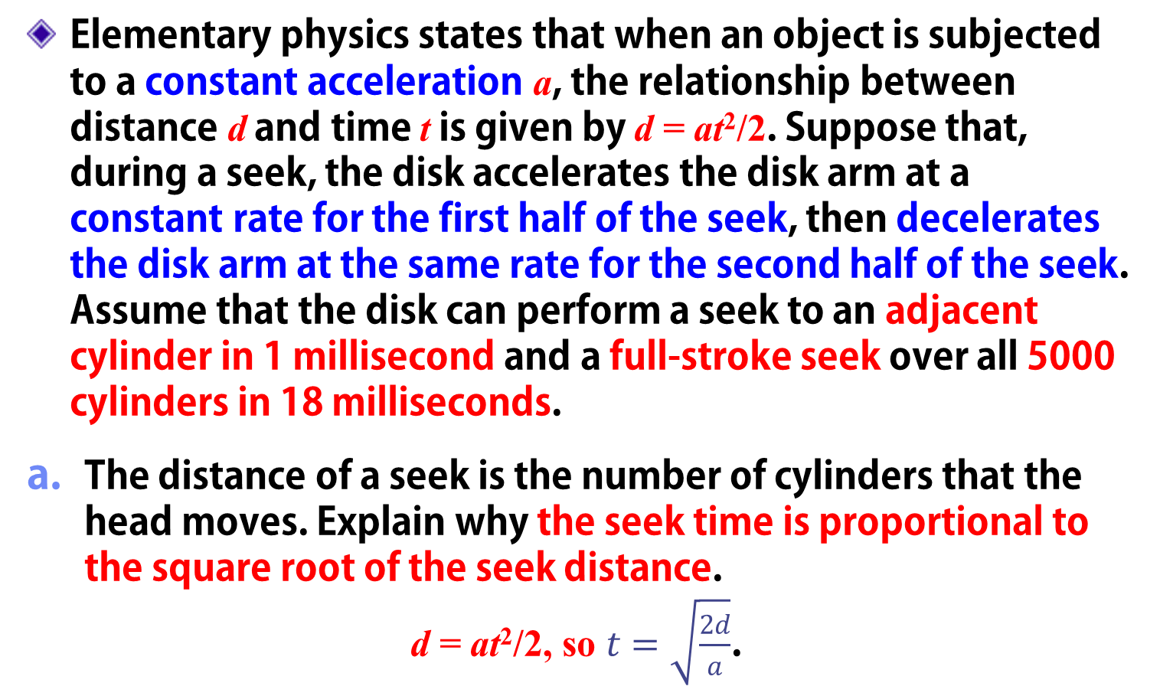
EX 10.12
Elementary physics states that when an object is subjected to a constant acceleration a, the relationship between distance d and time t is given by d = at²/2. Suppose that, during a seek, the disk accelerates the disk arm at a constant rate for the first half of the seek, then decelerates the disk arm at the same rate for the second half of the seek. Assume that the disk can perform a seek to an adjacent cylinder in 1 millisecond and a full-stroke seek over all 5000 cylinders in 18 milliseconds.
The distance of a seek is the number of cylinders that the head moves. Explain why the seek time is proportional to the square root of the seek distance.
d = at²/2, so $t=\sqrt{\frac{2d}{a}}$.

Slide 6
EX 10.12
Write an equation for the seek time as a function of the seek distance. This equation should be of the form t = x+ y√L , where t is the time in milliseconds and L is the seek distance in cylinders.
  Solve the simultaneous equations t = x+ y√L that result from (t = 1, L = 1) and (t = 18, L = 4999) to obtain
  t = 0.7561 + 0.2439√L .

Slide 7
EX 10.17
Consider a RAID Level 5 organization comprising five disks, with the parity for sets of four blocks on four disks stored on the fifth disk. How many blocks are accessed in order to perform the following? a) A write of one block of data ; b) A write of seven continuous blocks of data. (Assume that the seven contiguous blocks begin at a four-block boundary. )
a) read of the parity block, read of the old data stored in the target block, computation of the new parity based on the differences between the new and old contents of the target block, and write of the parity block and the target block.
b) writing the seven contiguous blocks, writing the parity block of the first four blocks, reading the eight block, computing the parity for the next set of four blocks and writing the corresponding parity block onto disk.

Slide 8
EX 10.19
Compare the performance of write operations achieved by a RAID Level 5 organization with that achieved by a RAID Level 1 organization.
RAID Level 1 organization can perform writes by simply issuing the writes to mirrored data concurrently.
RAID Level 5, on the other hand, would require the old contents of the parity block to be read before it is updated based on the new contents of the target block.
This results in more overhead for the write operations on a RAID Level 5 system.

Slide 9
EX 10.21
The reliability of a hard-disk drive is typically described in terms of a quantity called mean time between failures (MTBF). Although this quantity is called a “time,” the MTBF actually is measured in drive-hours per failure.
If a system contains 1000 drives, each of which has a 750,000-hour MTBF, which of the following best describes how often a drive failure will occur in that disk farm: once per thousand years, once per century, once per decade, once per year, once per month, once per week, once per day, once per hour, once per minute, or once per second?
750,000 drive-hours per failure divided by 1000 drives gives 750 hours per failure —about 31 days or once per month.

Slide 10
EX 10.21
The manufacturer guarantees a 1-million-hour MTBF for a certain model of disk drive. What can you conclude about the number of years for which one of these drives is under warranty?
Hard disk drives are generally designed to have a lifetime of five years. If such a drive truly has a million-hour MTBF, it is very unlikely that the drive will fail during its expected lifetime.

Slide 11
EX 11.10
The open-file table is used to maintain information about files that are currently open. Should the OS maintain a separate table for each user or just maintain one table that contains references to files that are being accessed by all users at the current time? If the same file is being accessed by two different programs or users, should there be separate entries in the open file table?
Consider a file that is currently being accessed by one or more processes. If the file is deleted, then it should not be removed from the disk until all processes accessing the file have closed it.
  This check can be performed only if there is centralized accounting of number of processes accessing the file.

Slide 12
EX 11.10
On the other hand, if two processes are accessing the file, then two separate states need to be maintained to keep track of the current location of which parts of the file are being accessed by the two processes.
This requires the OS to maintain separate entries for the two processes.

Slide 13
EX 11.19
What are the implications of supporting UNIX consistency semantics for shared access for those files that are stored on remote file systems?
UNIX consistency semantics requires updates to a file to be immediately available to other processes.
inefficiencies: all updates by a client have to be immediately reported to the file server instead of being batched, and updates have to be communicated by the file server to clients caching the data immediately, again resulting in more communication.

Slide 14
EX 12.10
Contrast the performance of the three techniques for allocating disk blocks (contiguous, linked, and indexed) for both sequential and random file access.
Contiguous Sequential - Works very well as the file is stored contiguously.
Sequential access - Simply involves traversing the contiguous disk blocks.
Contiguous Random -Works very well as you can easily determine the adjacent disk block containing the position you wish to seek to.
Linked Sequential - Satisfactory as you are simply following the links from one block to the next.

Slide 15
EX 12.10
Linked Random - Poor as it may require following the links to several disk blocks until you arrive at the intended seek point of the file.
Indexed Sequential - Works well as sequential access simply involves sequentially accessing each index.
Indexed Random - Works well as it is easy to determine the index associated with the disk block containing the position you wish to seek to.

Slide 16
EX 12.16
Consider a file system that uses inodes to represent files. Disk blocks are 8-KB in size and a pointer to a disk block requires 4 bytes. This file system has 12 direct disk blocks, plus single, double, and triple indirect disk blocks. What is the maximum size of a file that can be stored in this file system?
(12 * 8 KB) + (2048 * 8 KB) + (2048 * 2048 * 8 KB/) + (2048 * 2048 * 2048 * 8 KB) = 64 terabytes

Slide 17
EX 12.12
Consider a system where free space is kept in a free-space list.
a. Suppose that the pointer to the free-space list is lost. Can the system reconstruct the free-space list? Explain your answer.
In order to reconstruct the free list, it would be necessary to perform “garbage collection.” This would entail searching the entire directory structure to determine which pages are already allocated to jobs. Those remaining unallocated pages could be relinked as the free-space list.

Slide 18
EX 12.12
b. Consider a file system similar to the one used by UNIX with indexed allocation. How many disk I/O operations might be required to read the contents of a small local file at /a/b/c? Assume that none of the disk blocks is currently being cached.
Reading the contents of the small local file /a/b/c involves 4 separate disk operations: (1) Reading in the disk block containing the root directory /, (2) & (3) reading in the disk block containing the directories b and c, and reading in the disk block containing the file c.
c. Suggest a scheme to ensure that the pointer is never lost as a result of memory failure.
The free-space list pointer could be stored on the disk, perhaps in several places.

